Slide 1
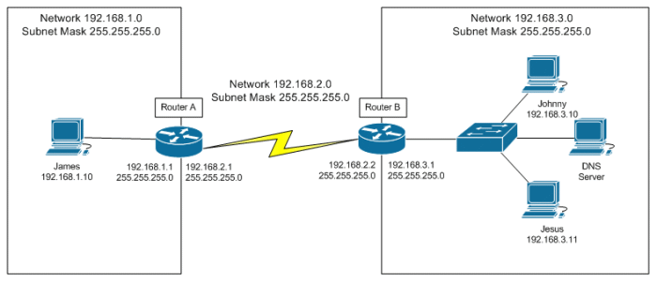
Introduction to IP Routing

Slide 2

What is a Router?
A router is a networking device that forwards data packets between computer networks. Routers perform the traffic directing functions on the Internet. Data sent through the internet, such as a web page or email, is in the form of data packets.

Slide 3
Routing Protocol Fundamentals
A routing protocol allows a router to dynamically learn how to reach other networks.
A routing protocol also allows the router to exchange learned network information with other routers or hosts.
Routing protocols may be used for connecting interior (internal) campus networks as well as for connecting different enterprises or routing domains.
Different routing protocols use different means of determining the best or most optimal path to a network or network node.

Slide 4
Routing Protocol Fundamentals Cont.
Some types of routing protocols work best in static environments or environments with few or no changes and might take a long time to converge when changes to those environments are made.
Other routing protocols, however, respond very quickly to changes in the network and can converge rapidly.
Network convergence occurs when all routers in the network have the same view and agree on optimal routes.
When convergence takes a long time to occur, intermittent packet loss and loss of connectivity may be experienced between remote networks

Slide 5
Routing Protocol Fundamentals Cont.
Because routing protocols have different characteristics, they differ in their scalability and performance.
Some routing protocols are suitable only for small networks, while others may be used in small, medium, and large networks.
Therefore, in addition to understanding the intricacies of routing protocols, it is also important to have a solid understanding of when and in what situation one routing protocol would be used versus another.

Slide 6
Flat and Hierarchical Routing Algorithms
Routing protocol algorithms operate using either a flat routing system or a hierarchical routing system
Flat routing system
Hierarchical routing system
A flat routing system has no hierarchy. In such systems, routers must typically be connected to every other router in the network and each router essentially has the same function.
Such algorithms work well in very small networks, however, they are no scalable.
In addition to this, as the network grows, troubleshooting becomes much more difficult because instead of just focusing your efforts on certain areas, for example, you now have to look at the entire network.
A hierarchical routing system uses a layered approach wherein routers are placed in logical groupings referred to domains, areas, or autonomous systems.
This allows different routers within the network to perform specific tasks, optimizing the functionality performed at those layers.
Some routers in the hierarchical system can communicate with other routers in other domains or areas, while some routers can only communicate with routers in the same domain or area.

Slide 7

Questions

Slide 8
IP Addressing
An IP address is divided into two parts.
The first part designates the network address while the second part designates the host address.
When designing network, an IP addressing scheme is used to uniquely identify hosts and devices within the network.
The IP addressing scheme should be hierarchical and should build on the traditional logical hierarchical model.
This allows the addressing scheme to provide designated points in the network where effective route summarization can be performed.

Slide 9
Address Summarization
Summarization reduces the amount of information that routers must process, which allows for faster convergence within the network.
Summarization also restricts the size of the area that is affected by network changes by hiding detailed topology information from certain areas within the network.

Slide 10
Administrative Distance
Administrative distance is used to determine the reliability of one source of routing information from another.
Some sources are considered more reliable than others; therefore, administrative distance can be used to determine the best or preferred path to a destination network or network node when there are two or more different paths to the same destination from two or more different routing protocols.
In Cisco IOS software, all sources of routing information are assigned a default administrative distance value.
This default value in an integer between 0 and 255, with a value of 0 assigned to the most reliable source of information and a value of 255 being assigned to the least reliable source of information.
Any routes that are assigned an administrative distance value of 255 are considered untrusted and will not be placed into the routing table.
The administrative distance is a locally significant value that affects only the local router.
This value is not propagated throughout the routing domain.
Therefore, manually adjusting the default administrative distance for a routing source or routing sources on a router affects the preference of routing information sources only on that router.

Slide 11
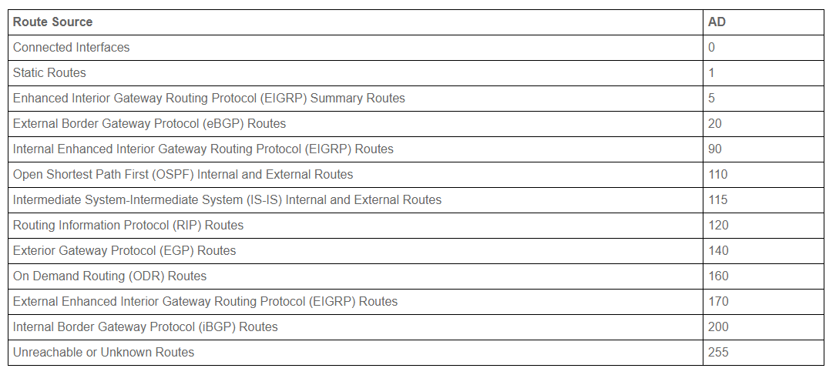
Administrative Distance Cont.

Slide 12
Routing Metrics
Routing protocol algorithms use metrics, which are numerical values that are associated with specific routes.
These values are used to prioritize of prefer routes learned by the routing protocol from the most preferred to the least preferred.
In essence, the lower the route metric, the more preferred the route by the routing protocol.
The route with the lowest metric is typically the route is the least cost or best route to the destination network.
This route will be placed into the routing table and be used to forward packets to the destination network.

Slide 13

Routing Metrics Cont.
The different routing protocol metrics may be based on one or more of the following:
Bandwidth
Cost
Delay
Load
Path Length
Reliability

Slide 14

Bandwidth
The term bandwidth refers to the amount of data that can be carried from one point to another in a given time period.
Routing algorithms may use bandwidth to determine which link type is preferred over another.
For example, a routing algorithm might prefer a GigabitEthernet link over a FastEthernet link because of the increased capacity of the GigabitEthernet link over the FastEthernet link.

Slide 15

Bandwidth Cont.
Bandwidth interface configuration command can be used to adjust the default bandwidth value for an interface, effectively manipulating the selection of one interface against another by a routing algorithm.
For example, if the FastEthernet interface was configured with the bandwidth 1000000interface configuration command, both the FastEthernet and GigabitEthernet links would appear to have the same capacity to the routing algorithm and would be assigned the same metric value.
The fact that one of the links is actually a FastEthernet interface while another is actually a GigabitEthernet link is irrelevant to the routing protocol

Slide 16

Cost
The cost, as it pertains to routing algorithms, actually refers to communication cost.
This refers to the actual monetary cost of link utilization.
The cost may be used when, for example, a company prefers to route across private links rather than public links that include monetary charges for sending data across them or for the usage time.
Intermediate System-to- Intermediate System (IS-IS) supports an optional expense metric measures the monetary cost of link utilization.

Slide 17
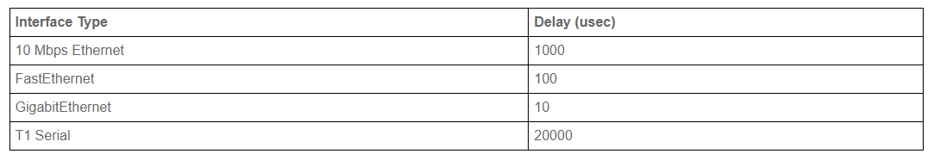
Delay
There are many types of delay, all of which affect different types of traffic.
In general, delay refers to the length of time required to move a packet from source to destination through the internetwork.
In Cisco IOS software, the interface delay value is in microseconds.
The interface value is configured using the delay interface configuration command.
When you configure the interface delay value, it is important to remember that this does not affect traffic.
For example, configuring a delay value of 5000 does not mean that traffic sent out of that interface will have an additional delay of 5000.

Slide 18
Load
The term load means different things to different people.
For example, in general computing terminology, the term load refers to the amount of work a resource, such as the CPU, is performing.
The term, as it applies in this context, refers to the degree of use for a particular router interface.
The load on the interface is as a fraction of 255.
For example, a load of 255/255 indicates that the interface is completely saturated, while a load of 128/255 indicates that the interface is 50% saturated.
By default, the load is calculated as an average over a period of five minutes.

Slide 19
Path Length
The path length metric is the total length of the path that is traversed from the local router to the destination network.
Different routing algorithms represent this in different forms.
For example, Routing Information Protocol (RIP) counts all intermediate routers (hops) between the local router and the destination network and uses the hop count as the metric.
Border Gateway Protocol (BGP) counts the number of traversed autonomous systems between the local router and destination network and uses the autonomous system count to select the best path.

Slide 20
Reliability
Like load, the term reliability means different things depending on the context in which it is used.
In this guide, unless stated otherwise, it should always be assumed that the term reliability refers to the dependability of network links or interfaces.
In Cisco IOS software, the reliability of a link or interface is represented as a fraction of 255.
As an example, a reliability value of 255/255 indicates the interface is 100% reliable. Similar to the interface load, by default the reliability of an interface is calculated as an average over a period of five minutes.

Slide 21

Questions

Slide 22
Configuration modes
There are mainly 5 modes in the switch:
User execution mode
Privileged mode
Global configuration mode
Interface configuration mode
ROMMON mode

Slide 23
User Execution mode
As soon as the interface up message appears and press enter, the router> prompt will pop up. This is called user execution mode. This mode is limited to some monitoring commands.
Privileged mode
As we type enable to user mode, we enter into Privileged mode where we can view and change the configuration of the router. Different commands like show running-configuration, show IP interface brief, etc can run on this mode which is used for troubleshooting purposes.
Global configuration mode
As we type configure terminal to the user mode, we will enter into the global configuration mode. Commands entered in these modes are called global commands and they affect the running configuration of the router. In this mode, a different configuration like making a local database on the router by providing username and password can set enable and secret password, etc.

Slide 24
Interface Configuration mode
In this mode, only the configuration of interfaces is done. Assigning an IP address to an interface, bringing up the interface are the common tasks done in this mode.
Rommon mode
We can enter this mode when we interrupt the boot process of the router. Generally, we enter in this mode while the password recovery process or Backing up of IOS on devices like TFTP server. It is like the BIOS mode of a PC.

Slide 25
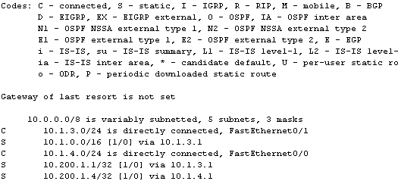
What is a Routing Table
In computer networking, a routing table, or routing information base, is a data table stored in a router or a network host that lists the routes to particular network destinations, and in some cases, metrics associated with those routes

Slide 26
Routing Tables Cont.
Without a populated routing table that contains entries for remote networks, routers will not be able to forward packets to those remote networks.
The routing table may include specific network entries or simply a single default route.
The information in the routing table is used by the forwarding process to forward traffic to the destination network or host.
The routing table itself does not actually forward traffic.

Slide 27
Routing Tables Cont.
Cisco routers use the administrative distance, routing protocol metric, and the prefix length to determine which routes will actually be placed into the routing table, which allows the router to build the routing table. The routing table is built using the following general steps:
If the route entry does not currently exist in the routing table, add it to the routing table
If the route entry is more specific than an existing route, add it to the routing table. It should also be noted that the less specific entry is still also retained in the routing table
If the route entry is the same as an existing one, but is received from a more preferred route source, replace the old entry with the new entry
If the route entry is the same as an existing one, and is received from the same protocol:
Discard the new route if the metric is higher than the existing route
Replace the existing route if the metric of the new route is lower
If the metric for both routes is the same, use both routes for load-balancing

Slide 28
Routing Tables Cont.
The routing protocol with the lowest administrative distance value will always win when the router is determining which routes to place into the routing table.
For example, if a router receives the 10.0.0.0/8 prefix via external EIGRP, OSPF, and internal BGP, the OSPF route will be placed into the routing table.
If that route is removed or is no longer received, the external EIGRP route will be placed into the routing table.
And finally, if both the OSPF and external EIGRP routes are no longer present, the internal BGP route is used

Slide 29
Questions

Slide 30
Routing Protocols
The purpose of routing protocols is to learn of available routes that exist on the enterprise network, build routing tables and make routing decisions.
Some of the most common routing protocols include
Static Routes
RIP
IGRP
EIGRP
OSPF
BGP
iBGP
eBGP

Slide 31
Routing Protocol Types
Distance vector protocols
Link state protocols
Advertise their routing table to all directly connected neighbors at regular frequent intervals using a lot of bandwidth and are slow to converge.
When a route becomes unavailable, all router tables must be updated with that new information.
The problem is with each router having to advertise that new information to its neighbors, it takes a long time for all routers to have a current accurate view of the network.
Distance vector protocols use fixed length subnet masks which aren’t scalable.
Advertise routing updates only when they occur which uses bandwidth more effectively.
Routers don’t advertise the routing table which makes convergence faster.
The routing protocol will flood the network with link state advertisements to all neighbor routers per area in an attempt to converge the network with new route information
The incremental change is all that is advertised to all routers as a multicast LSA update. They use variable length subnet masks, which are scalable and use addressing more efficiently.

Slide 32
IP Routes (Static Routes)
A static IP route specifies the route's destination address and the next-hop router's IP address or routing switch interface through which the routing switch can reach the destination.
A static route is a pre-determined pathway that a packet must travel to reach a specific host or network.
Some ISPs require static routes to build your routing table instead of using dynamic routing protocols.
Static routes do not require CPU resources to exchange routing information with a peer router.
You can also use static routes to reach peer routers that do not support dynamic routing protocols.
Static routes can be used together with dynamic routes.

Slide 33
IP Routes (Static Routes)
When you configure a static IP route, you must specify the following parameters:
The IP address and network mask for the route's destination network or host.
The route's path, which can be one of the following:
IP address of your next-hop router.

Slide 34
Routing Information Protocol (RIP)
Routing Information Protocol (RIP) is a distance vector protocol that uses hop count as its primary metric.
RIP defines how routers should share information when moving traffic among an interconnected group of local area networks (LANs).
Each router broadcasts its entire routing table to its closest neighbors every 30 seconds.
In this context, neighbors are the other routers to which a router is connected directly -- that is, the other routers on the same network segments as the selected router.
The neighbors, in turn, pass the information on to their nearest neighbors, and so on, until all RIP hosts within the network have the same knowledge of routing paths.
This shared knowledge is known as convergence.

Slide 35
RIP Cont.
RIPv1
RIPv2
RIPv1 is also called Classful Routing Protocol because it does not send subnet mask information in its routing updates.
Uses broadcast for updates
RIPv2 is called Classless Routing Protocol because it does send subnet mask information in its r
Uses multicast for updates

Slide 36
Interior Gateway Routing Protocol (IGRP)
Interior Gateway Routing Protocol is a distance vector routing protocol developed by Cisco systems for routing multiple protocols across small and medium sized Cisco networks.
IGRP will route IP, IPX, Decnet and AppleTalk which makes it very versatile for clients running many different protocols.
It is somewhat more scalable than RIP since it supports a hop count of 100, only advertises every 90 seconds and uses a composite of five different metrics to select a best path destination.

Slide 37
Enhanced Interior Gateway Routing Protocol (EIGRP)
A hybrid routing protocol developed by Cisco systems for routing many protocols across an enterprise Cisco network.
It has characteristics of both distance vector routing protocols and link state routing protocols. It is proprietary which requires that you use Cisco routers.
EIGRP will route the same protocols that IGRP routes (IP, IPX, Decnet and Appletalk) and use the same composite metrics as IGRP to select a best path destination.
Summarization is automatic at a network class address however it can be configured to summarize at subnet boundaries as well.
Redistribution between IGRP and EIGRP is automatic as well. There is support for a hop count of 255 and variable length subnet masks.

Slide 38
EIGRP Cont.
Convergence with EIGRP is faster since it uses an algorithm called dual update algorithm or DUAL, which is run when a router detects that a particular route is unavailable.
The router queries its neighbors looking for a feasible successor.
That is defined as a neighbor with a least cost route to a particular destination that doesn’t cause any routing loops.
EIGRP will update its routing table with the new route and the associated metric.
Route changes are advertised only to affected routers when changes occur.
That utilizes bandwidth more efficiently than distance vector routing protocols.

Slide 39
EIGRP Cont. Autonomous System Numbers
EIGRP does recognize assignment of different autonomous systems which are processes running under the same administrative routing domain.
Assigning different autonomous system numbers isn’t for defining a backbone such as with OSPF.
With IGRP and EIGRP it is used to change route redistribution, filtering and summarization points

Slide 40
Questions

Slide 41
Open Shortest Path First (OSPF)
Open Shortest Path First is a true link state protocol developed as an open standard for routing IP across large multi-vendor networks.
A link state protocol will send link state advertisements to all connected neighbours of the same area to communicate route information.
Each OSPF enabled router, when started, will send hello packets to all directly connected OSPF routers.
The hello packets contain information such as router timers, router ID and subnet mask.
If the routers agree on the information they become OSPF neighbours. Once routers become neighbours they establish adjacencies by exchanging link state databases.
Routers on point-to-point and point-to-multipoint linksautomatically establish adjacencies.
Routers with OSPF interfaces configured as broadcast (Ethernet) and NBMA (Frame Relay) will use a designated router that establishes those adjacencies.

Slide 42

Open Shortest Path First (OSPF)
Fast convergence is accomplished with the SPF (Dijkstra) algorithm which determines a shortest path from source to destination.
The routing table is built from running SPF which determines all routes from neighbor routers.
Since each OSPF router has a copy of the topology database and routing table for its particular area, any route changes are detected faster than with distance vector protocols and alternate routes are determined.
Broadcast networks such as Ethernet and Non-Broadcast Multi Access networks such as Frame Relay have a designated router (DR) and a backup designated router (BDR) that are elected.
Designated routers establish adjacencies with all routers on that network segment.
This is to reduce broadcasts from all routers sending regular hello packets to its neighbors.
The DR sends multicast packets to all routers that it has established adjacencies with.
If the DR fails, it is the BDR that sends multicasts to specific routers.
Each router is assigned a router ID, which is the highest assigned IP address on a working interface.
OSPF uses the router ID (RID) for all routing processes.

Slide 43
Border Gateway Protocol (BGP)
Border Gateway Protocol is an exterior gateway protocol, which is different from the interior gateway protocols discussed so far.
The distinction is important since the term autonomous system is used somewhat differently with protocols such as EIGRP than it is with BGP.
Exterior gateway protocols such as BGP route between autonomous systems, which are assigned a particular AS number.
AS numbers can be assigned to an office with one or several BGP routers.
The BGP routing table is comprised of destination IP addresses, an associated AS-Path to reach that destination and a next hop router address.
The AS-Path is a collection of AS numbers that represent each office involved with routing packets.
Contrast that with EIGRP, which uses autonomous systems as well.
The difference is their autonomous systems refer to a logical grouping of routers within the same administrative system.

Slide 44
Internal Border Gateway Protocol (iBGP)
It runs between two BGP routers in the same autonomous system
Its default Administrative Distance is 200.
IBGP routes received from an IBGP peer cannot be advertised to another IBGP peer but can be advertised to an EBGP peer.
IBGP routes received from an IBGP peer cannot be advertised to another IBGP peer but can be advertised to an EBGP peer.
It is used within the same organization.
In IBGP peers, attributes like local preference are sent.
When route is advertised to IBGP peer, next hop remains unchanged..
It default peers are set with TTL = 255.
It uses BGP Split horizon for loop prevention

Slide 45
External Border Gateway Protocol (eBGP)
It runs between two BGP routers in a different autonomous system.
Its default Administrative Distance is 20
EBGP routes received from an EBGP peer can be advertised to EBGP and IBGP peers
It does not require full mesh topology.
It is used between organizations or between organizations and Internet Service Providers.
It uses as path for loop prevention.
It default peers are set with TTL = 1.
In EBGP peers, attributes like local preference are not sent.

Slide 46
Classful vs Classless Protocols
Classful routing protocols do not send subnet mask information in their routing updates.
Classless routing protocols include subnet mask information in the routing updates.

Slide 47
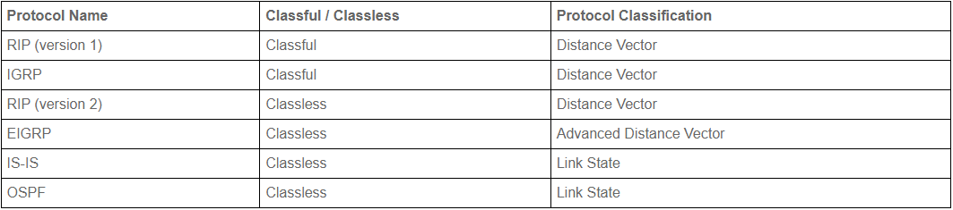
Classful vs Classless Protocols Cont.

Slide 48
Example Configs
Static
Router(config)# ip route 10.0.0.0 255.0.0.0 10.1.1.1
RIP
Router(config)# Rotuer rip
Router(config-router)# network 10.0.0.0
Router(config-router)# version 2
Router(config-router)# no auto-summary
IGP
Router(config)# Router igrp 1
Router(config-router)# network 10.20.30.1
Router(config-router)# no auto-summary
EIGRP
Router(config)# Router eigrp 1
Router(config-router)#network 10.20.30.1
Router(config-router)# no auto-summary
OSPF
Router(config)# router ospf 1
Router(config-router)# network 10.10.10.1 0.0.0.3 area 0
Router(config-router)# no auto-summary
BGP
Router(config)# router bgp 45000
Router(config-router)# bgp log-neighbor-changes
Router(config-router)# neighbor 192.168.1.2 remote-as 45000

Slide 49
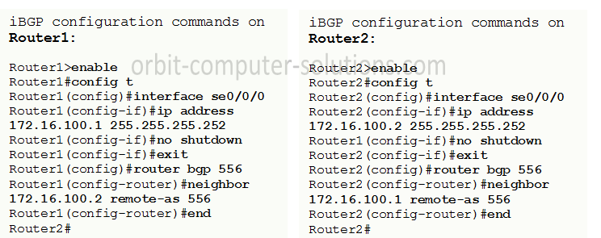
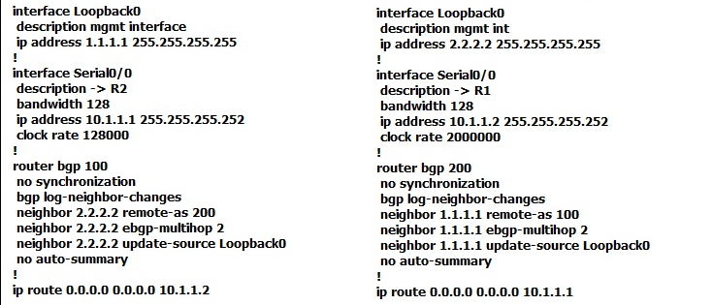

Slide 50
Questions

